Slide 1

Intro to
Programming
With python
Sequences:
Transforming part II
Monday, March 24 2025 TOH210
Notes:
Layout objects pulled from: https://slidesgo.com/
All icons are from: https://thenounproject.com/

Slide 2

Transforming
Sequences 2
colab workbook
click for access
found on Moodle under this week

Slide 3

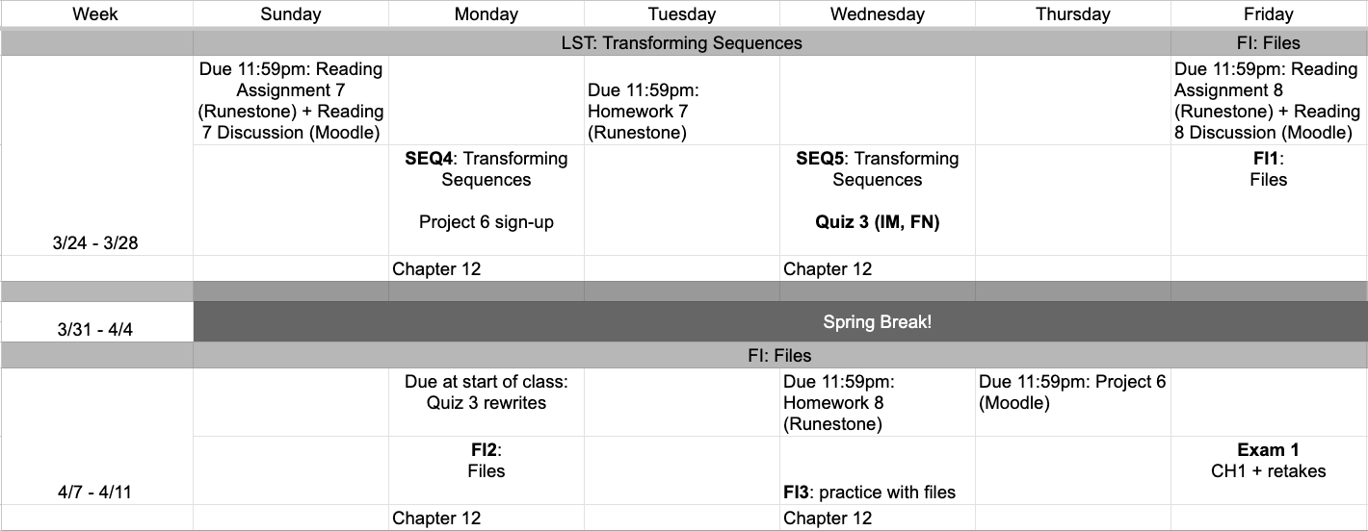
This week
google sheet link
Notes:
https://docs.google.com/forms/d/e/1FAIpQLSe3OloPAJSid4n6cyU_4qXpRWU7FOSmP7IVdRS_vh9cvYd9zQ/viewform?usp=sharing

Slide 4
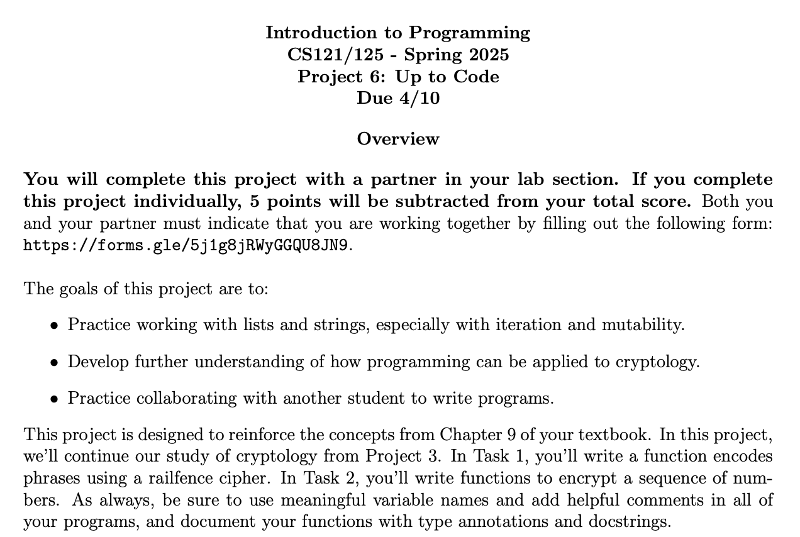

Find a new partner to work with. If you need one, stand up (look for others also standing)

Slide 5

Warm-up
double trouble
Define a function double_evens that takes in a list of numbers (input_list) and doubles the value of every even number in the list.
The function should modify the list.
For example:
my_list = [1,2,3,4,5]
double_evens(my_list)
print(my_list)
Should display [1,4,3,8,5]
Grab a partner, and a whiteboard marker.
Focus on function header including documentation, then outline function body with comments, then add Python code to implement.

Slide 6
We've already seen append, which adds an item to the end of the list:
list methods We've been changing lists in ways that don't change the length of the list.
We can use list methods
to add or remove items from a list, that will change the number of items in that list and thus it’s length
my_list = [1, 2, 3, 4]
my_list.append("potato")
print(my_list)
[1, 2, 3, 4,"potato"]
Insert can be used to insert a new item at a specified index:
my_list = [1, 2, 3, 4]
my_list.insert(1,"potato")
print(my_list)
[1, "potato",2, 3, 4]

Slide 7
Remove can be used to remove the first occurrence of an item
list methods We've been changing lists in ways that don't change the length of the list.
We can use list methods
to add or remove items from a list, that will change the number of items in that list and thus it’s length
my_list = [1, 2, 3, 4, 3, 2, 1]
my_list.remove(2)
print(my_list)
[1, 3, 4, 3, 2, 1]
pop can be used to remove the item at a specified index, and returns the item that was at that location
my_list = [1, 2, 3, 4, 3, 2, 1]
item=my_list.pop(3)
print(my_list)
print(item)
[1, 2, 3, 3, 2, 1]
4

Slide 8
Without calling an argument, pop will return the last item in the list
list methods We've been changing lists in ways that don't change the length of the list.
We can use list methods
to add or remove items from a list, that will change the number of items in that list and thus it’s length
my_list = [1, 2, 3, 4, 3, 2, 1]
item=my_list.pop()
print(my_list)
print(item)
[1, 2, 3, 4, 3, 2 ]
1
del can remove a single item from a list
or an entire slice
my_list = [1, 2, 3, 4, 3, 2, 1]
del my_list[0]
print(my_list)
[ 2, 3, 4, 3, 2, 1]
my_list = [1, 2, 3, 4, 3, 2, 1]
del my_list[0:3]
print(my_list)
[ 4,3, 2, 1]

Slide 9
Exercise
list method practice
Write a program that does the following:
Create a list containing the numbers 1 through 20
Remove the number 13 from the list.
Append 7 to the end of the list.
Remove the number at index 15, and append it to the end of the list.
Insert the string "hi" at index 0 .
Remove the items at indices 2 through 6.
Print the list.
List methods:
my_list.append(item)
my_list.insert(index, item)
my_list.remove(item)
my_list.pop(index)
my_list.pop()
del my_list[index]
del my_list[start:stop]
Remember we can create lists by list(range(start, stop, step))

Slide 10
cloning a list
We could instead create and return a new list
def remove_first(input_list:list)->None:
"""Takes a list as an argument, and
removes the first item from the list"""
input_list.pop(0)
lst = [1,2,3]
print(remove_first(lst))
print(lst)
def remove_first(input_list:list)->list:
"""Takes a list as an argument, and
removes the first item from the list"""
clone = []
for item in input_list:
clone.append(item)
clone.pop(0)
return clone
lst = [1,2,3]
print(remove_first(lst))
print(lst)
None
[2,3]
What if we want a function that doesn’t make changes to the list we pass in?
clone
[2,3]
[1,2,3]

Slide 11
We can use slicing to create the clone list, rather than iteration by item
We cannot assign clone to input_list
def remove_first(input_list:list)->list:
"""Takes a list as an argument, and
removes the first item from the list"""
clone = input_list[:]
clone.pop(0)
return clone
lst = [1,2,3]
print(remove_first(lst))
print(lst)
def remove_first(input_list:list)->list:
"""Takes a list as an argument, and
removes the first item from the list"""
clone = input_list
clone.pop(0)
return clone
lst = [1,2,3]
print(remove_first(lst))
print(lst)
this changes both clone and input_list
…why?
clone
clone
[2,3]
[2,3]
[1,2,3]
[2,3]

Slide 12
namespace
objectspace
a = [1,2,3]
b = a
a
1
0
1
2
Here b is an alias or shallow copy of a which means it’s another name for the same object
b
2
3
namespace
objectspace
a = [1,2,3]
b = a[:]
a
1
0
1
2
Here b is an clone or deep copy of a which means it links to a distinct object (new thing in objectspace) that has the same properties as a
2
3
b
0
1
2

Slide 13
Exercises
squares1
Define a function squares1 which takes a list of integers (int_list) as an argument, and replaces every item in the list with its square
First create the function header, adding in type annotations and a docstring.
Ask yourself if this function should return something, or is it simply doing a list operation. If returning something, consider a clone.
Fill in the rest of the function definition and test using function call.
squares2
Define a function squares2 which takes a list of integers (int_list) as an argument, and returns a list containing the squares of the list of integers

Slide 14

before next time
Finish workbook
Meet up with Project 6 partner this week
Study for Quiz 3

Slide 15
def double_evens(input_list:list)->None:
"""Takes in a list of numbers (input_list)
and doubles the value of every even number in the list """
#go through input_list so that changes are saved
for index in range(len(input_list)):
#if item is even
if input_list[index] % 2 == 0:
#double it
input_list[index] = input_list[index] *2
my_list = list(range(1,21))
my_list.remove(13)
my_list.append(7)
item_15 = my_list.pop(15)
my_list.append(item_15)
my_list.insert(0, "hi")
del my_list[2:7]
my_list
SOLUTIONS

